Slide 1
Microsoft
Aadhivk

Slide 2
founders
CEO: Satya Nadella (Feb 4, 2014–)
CFO: Amy Hood
CMO: Takeshi Numoto
CTO: Kevin Scott, Victor Bahl
President: Bradford L. Smith
Founders: Bill Gates, Paul Allen
Headquarters: Redmond, WA

Slide 3
when was microsoft founded
Gates and Allen established Microsoft on April 4, 1975, with Gates as CEO, and Allen suggested the name "Micro-Soft", short for micro-computer software.

Slide 4
what industry is microsoft
Microsoft operates primarily in the technology industry, with a focus on software, services, devices, and solutions. They are a leading developer and provider of software products, cloud-based solutions, and hardware.

Slide 5
Is microsoft publicly traded
Yes, Microsoft (MSFT) is publicly traded. Its shares are listed on The Nasdaq Stock Market. The ticker symbol for Microsoft is MSFT. Microsoft became a publicly traded company in 1986.

Slide 6
what is stocks of microsoft
506.73
USD
−3.04 (0.60%)today
Aug 20, 1:36 PM EDT •
510.34 USD ‎9:30 AM

Slide 7
is microsoft producing revenue
Yes, Microsoft is actively producing revenue through its various segments

Slide 8
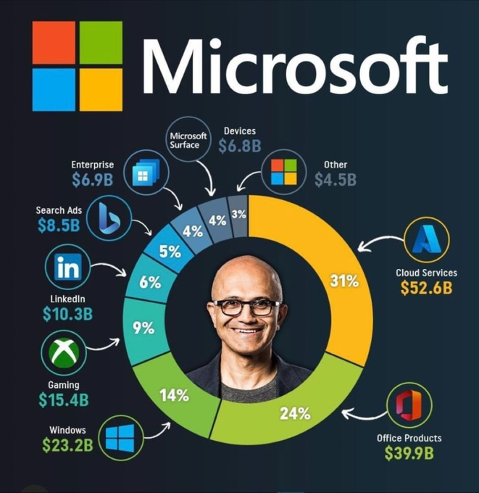
what is microsoft revenue 2021
In fiscal year 2021, Microsoft reported a total revenue of $168.088 billion, marking an 18% increase compared to the previous year.

Slide 9
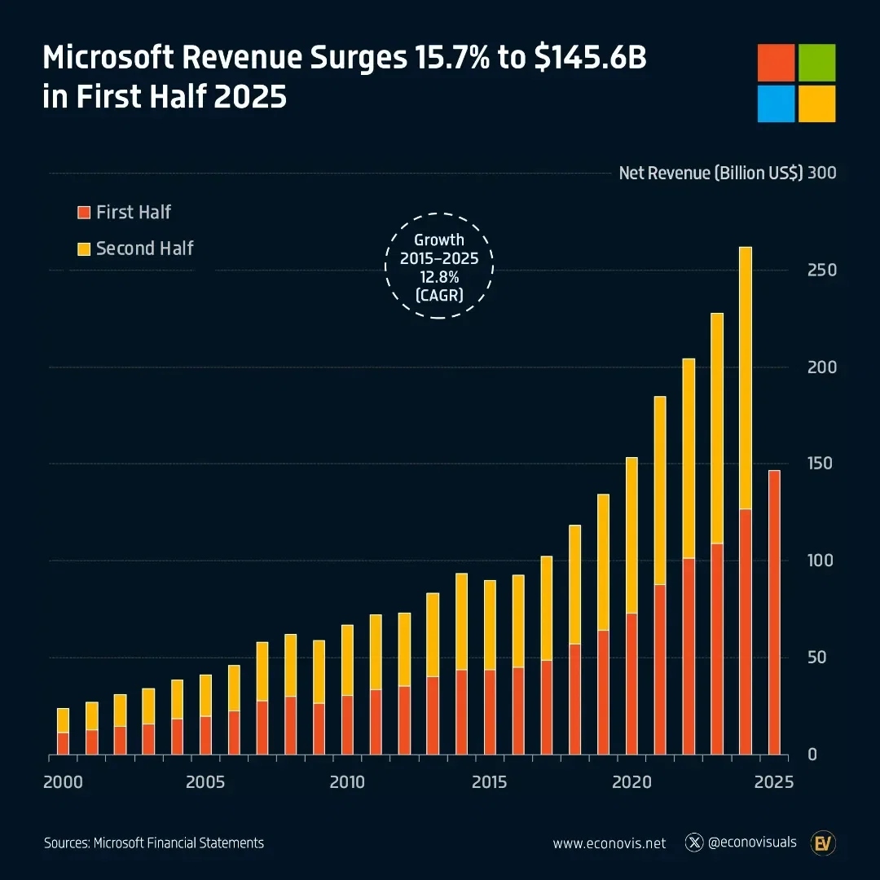
what is microsoft revenue 2025
In fiscal year 2025 (FY25), Microsoft reported an annual revenue of $281.7 billion, marking a 15% increase compared to the previous fiscal year.
Specifically, for the fourth quarter of FY25 (ending June 30, 2025), Microsoft's revenue was $76.4 billion, an 18% increase year-over-year. This growth was driven by strong demand for cloud and AI services.

